Slide 1
Probability
Willard Williamson
Adjunct Professor
iSchool, Syracuse University
linkedin.com/in/ncc-1701-d

Slide 2
Credits
Thanks to the openintro project for providing lecture slides on conditional probability: https://www.openintro.org/stat/teachers.php
Thanks toSt. Francis Xavier University for lecture slides on the uniform distribution: http://people.stfx.ca/jquinn/STAT%20231/Class%20Power%20points/Lecture%209%20Uniform%20and%20normal%20distributions.ppt
A nice review on joint, marginal, and conditional probability: https://sites.nicholas.duke.edu/statsreview/jmc/

Slide 3
Objectives
Review of common probability concepts
Not an exhaustive survey
Highly recommended to take a probability and statistics class
Probability and statistics is very important to data scientists

Slide 4
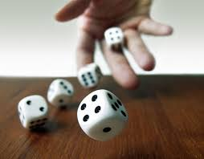
What is Probability
Probability is a measure of uncertainty
We can try to compute the probability of almost any event
An event is the basic element to which probability can be applied
Events:
An observation or the result of an experiment
like heads vs. tails
A description of a potential outcome
Notes:
https://www.google.com/url?sa=i&source=images&cd=&ved=2ahUKEwj5uemno4XjAhVuTd8KHX8MCewQjRx6BAgBEAU&url=https%3A%2F%2Fspikeybits.com%2F2016%2F12%2Fmake-your-own-dice-roller-for-around-3-tutorial.html&psig=AOvVaw2XLa_5PMPUIwGSfumulC-I&ust=1561573812436822

Slide 5
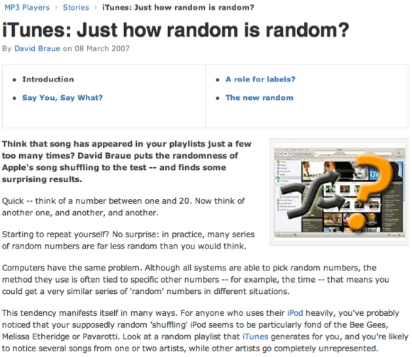
Random processes
A random process is a situation in which we know what outcomes could happen, but we don't know which particular outcome will happen.
Examples: coin tosses, die rolls, iTunes shuffle, whether the stock market goes up or down tomorrow, etc.
It can be helpful to model a process as random even if it is not truly random.
http://www.cnet.com.au/itunes-just-how-random-is-random-339274094.htm

Slide 6
Probability
There are several possible interpretations of probability but they (almost) completely agree on the mathematical rules probability must follow.
P(A) = Probability of event A
0 ≤ P(A) ≤ 1

Slide 7
Probability
There are several possible interpretations of probability but they (almost) completely agree on the mathematical rules probability must follow.
P(A) = Probability of event A
0 ≤ P(A) ≤ 1

Slide 8
Two Views on Statistical Learning
Bayesian statistics
Frequentist Statistics
Notes:
In this course, we will use frequentist statistics (MLE), which is sometimes much easier to apply than Bayesian statistics but has some theoretical weaknesses.

Slide 9
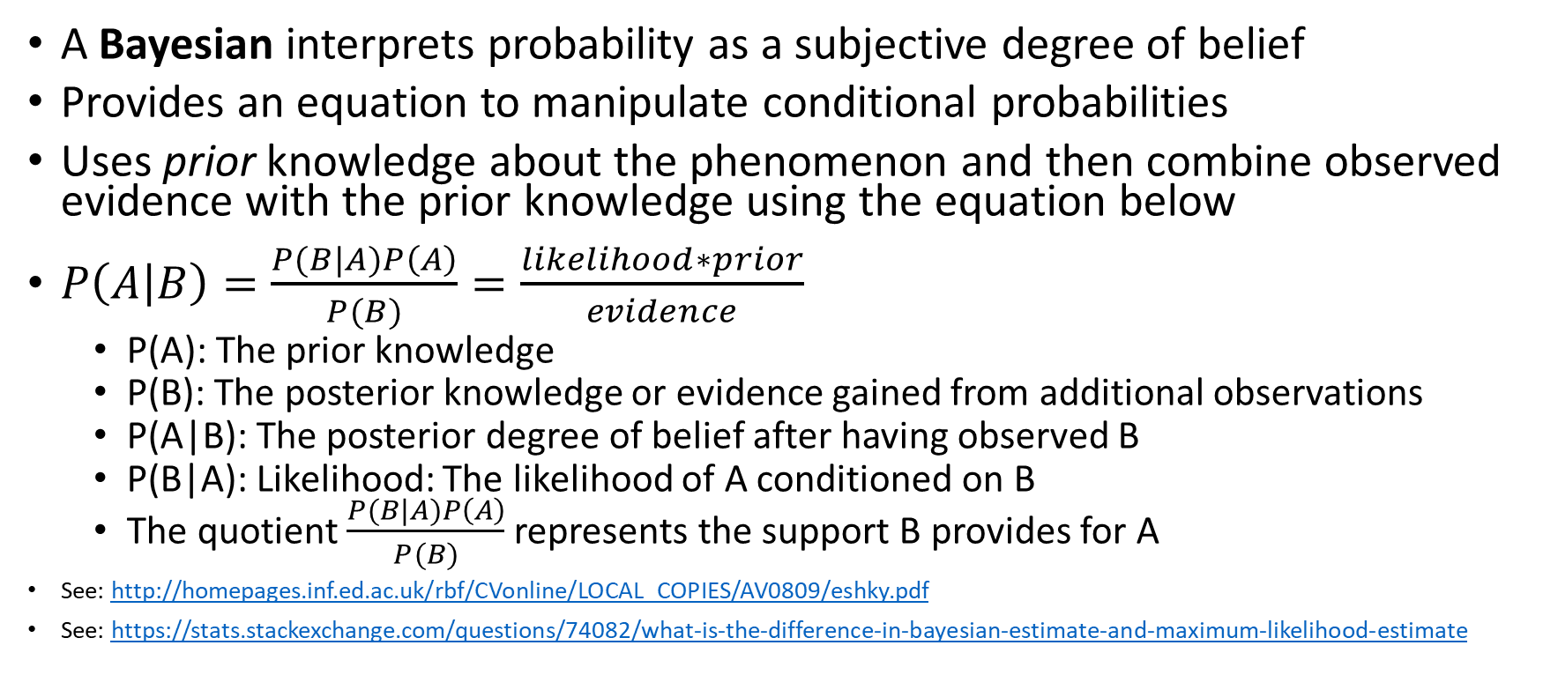
Bayesian
A Bayesian interprets probability as a subjective degree of belief
Provides an equation to manipulate conditional probabilities
Uses prior knowledge about the phenomenon and then combine observed evidence with the prior knowledge using the equation below
$P\left(A | B\right)=\frac{P(B|A)P\left(A\right)}{P(B)}=\frac{likelihood∗prior}{evidence}$
P(A): The prior knowledge
P(B): The posterior knowledge or evidence gained from additional observations
P(A|B): The posterior degree of belief after having observed B
P(B|A): Likelihood: The likelihood of A conditioned on B
The quotient $\frac{P(B|A)P\left(A\right)}{P(B)}$ represents the support B provides for A
See: http://homepages.inf.ed.ac.uk/rbf/CVonline/LOCAL_COPIES/AV0809/eshky.pdf
See: https://stats.stackexchange.com/questions/74082/what-is-the-difference-in-bayesian-estimate-and-maximum-likelihood-estimate
Notes:
In this course, we will use frequentist statistics (MLE), which is sometimes much easier to apply than Bayesian statistics but has some theoretical weaknesses.

Slide 10
Frequentist
Frequentist statistics:
The probability of an outcome is the proportion of times the outcome would occur if we observed the random process an infinite number of times.
Makes an estimate of a parameter based on sample data.
It assumes a procedure where samples from the same population will be observed an infinite number of times.
It uses sampling with replacement
The samples build the distribution
We will use the frequentist interpretation in IST-718
Notes:
In this course, we will use frequentist statistics (MLE), which is sometimes much easier to apply than Bayesian statistics but has some theoretical weaknesses.

Slide 11
Disjoint and non-disjoint outcomes
Disjoint (mutually exclusive) outcomes: Cannot happen at the same time.
The outcome of a single coin toss cannot be a head and a tail.
A student both cannot fail and pass a class.
A single card drawn from a deck cannot be an ace and a queen.

Slide 12
Disjoint and non-disjoint outcomes
Disjoint (mutually exclusive) outcomes: Cannot happen at the same time.
The outcome of a single coin toss cannot be a head and a tail.
A student both cannot fail and pass a class.
A single card drawn from a deck cannot be an ace and a queen.
Non-disjoint outcomes: Can happen at the same time.
A student can get an A in Stats and A in Econ in the same semester.

Slide 13
General Addition Rule
General addition rule
P(A or B) = P(A) + P(B) - P(A and B)
Notes:
For disjoint events P(A and B) = 0, so the above formula simplifies to P(A or B) = P(A) + P(B)
P(A or B) occurs means A, B, or both A and B

Slide 14
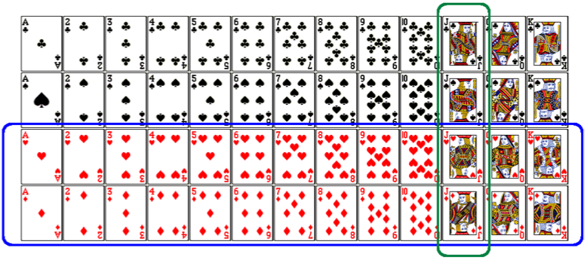
Union of non-disjoint events
What is the probability of drawing a jack or a red card from a well shuffled full deck?
Figure from http://www.milefoot.com/math/discrete/counting/cardfreq.htm

Slide 15
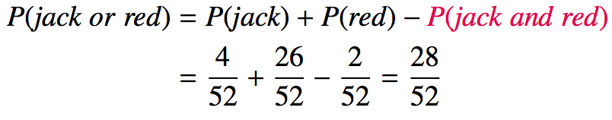
Union of non-disjoint events
What is the probability of drawing a jack or a red card from a well shuffled full deck?
Figure from http://www.milefoot.com/math/discrete/counting/cardfreq.htm

Slide 16
Probability Distributions

Slide 17
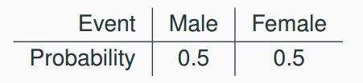
Probability distributions
A probability distribution lists all possible events and the probabilities with which they occur.
The probability distribution for the gender of one kid:

Slide 18
Probability distributions
A probability distribution lists all possible events and the probabilities with which they occur.
The probability distribution for the gender of one kid:
Rules for probability distributions:
1. The events listed must be disjoint
2. Each probability must be between 0 and 1
3. The probabilities must total 1

Slide 19
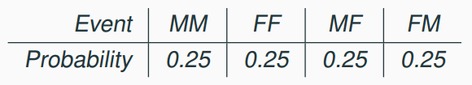
Probability distributions
A probability distribution lists all possible events and the probabilities with which they occur.
The probability distribution for the gender of one kid:
Rules for probability distributions:
1. The events listed must be disjoint
2. Each probability must be between 0 and 1
3. The probabilities must total 1
The probability distribution for the genders of two kids:

Slide 20
Random Variables

Slide 21
Random variables
A random variable is a numeric quantity whose value depends on the outcome of a random event
We use a capital letter, like X, to denote a random variable
The values of a random variable are denoted with a lowercase letter, in this case x
For example, P(X = x)
There are two types of random variables:
Discrete random variables often take only integer values
Example: Number of credit hours, Difference in number of credit hours this term vs last
Continuous random variables take real (decimal) values
Example: Cost of books this term, Difference in cost of books this term vs last

Slide 22
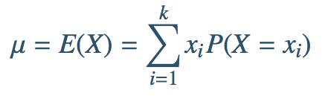
Expectation
We are often interested in the average outcome of a random variable.
We call this the expected value (mean), and it is a weighted average of the possible outcomes

Slide 23
Expected value
of a discrete random variable
In a game of cards you win $1 if you draw a heart, $5 if you draw an ace (including the ace of hearts), $10 if you draw the king of spades, and nothing for any other card you draw. Write the probability model for your winnings, and calculate your expected winning.

Slide 24
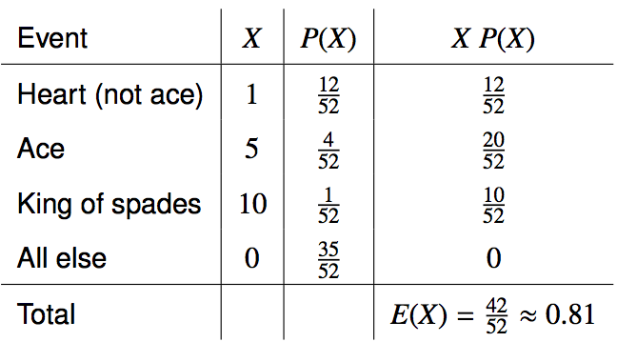
Expected value
of a discrete random variable
In a game of cards you win $1 if you draw a heart, $5 if you draw an ace (including the ace of hearts), $10 if you draw the king of spades and nothing for any other card you draw. Write the probability model for your winnings, and calculate your expected winning.

Slide 25
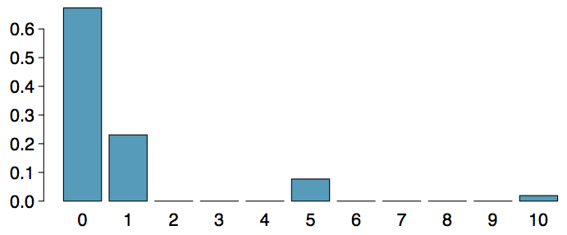
Expected value
of a discrete random variable (cont.)
Below is a visual representation of the probability distribution of winnings from this game:

Slide 26

Variance
Variance is roughly the average squared deviation from the mean.

Slide 27
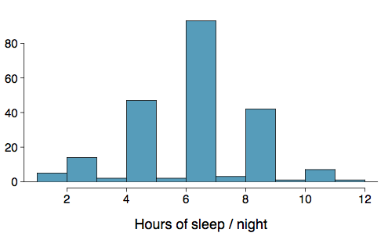
Variance
Variance is roughly the average squared deviation from the mean.
Calculate the variance for student sleep

Slide 28

Variance
Variance is roughly the average squared deviation from the mean.
Calculate the variance for student sleep
The sample mean is and the sample size is n = 217.

Slide 29
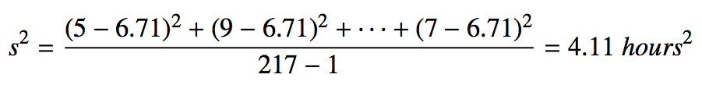
Variance
Variance is roughly the average squared deviation from the mean.
Calculate the variance for student sleep
The sample mean is and the sample size is n = 217.
The variance of amount of sleep students get per night can be calculated as:

Slide 30
Variance (cont.)
Why do we use the squared deviation in the calculation of variance?

Slide 31
Variance (cont.)
Why do we use the squared deviation in the calculation of variance?
To get rid of negatives so that observations equally distant from the mean are weighed equally.
To weigh larger deviations more heavily.

Slide 32

Standard Deviation
The standard deviation is the square root of the variance, and has the same units as the data.

Slide 33
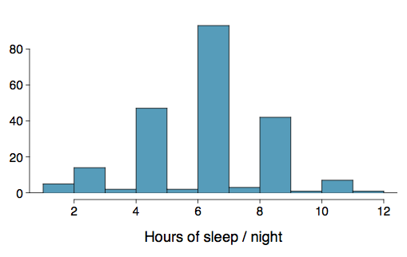

Standard Deviation
The standard deviation is the square root of the variance, and has the same units as the data.
The standard deviation of amount of sleep students get per night can be calculated as:

Slide 34
Standard Deviation
The standard deviation is the square root of the variance, and has the same units as the data.
The standard deviation of amount of sleep students get per night can be calculated as:
We can see that all of the data are within 3 standard deviations of the mean.

Slide 35
Marginal, Conditional, and Joint Probability

Slide 36
Marginal Probability
The probability of an event occurring (p(A)), it may be thought of as an unconditional probability.
Example: The probability of drawing a red card equals the number of red cards divided by the total number of cards: 26/52 = 0.5.

Slide 37
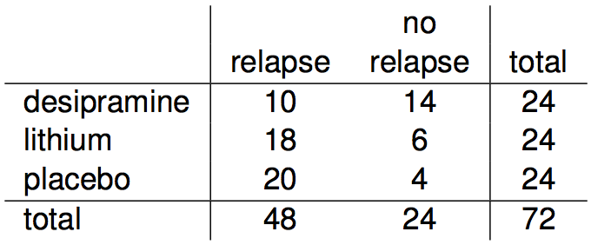
Relapse
Researchers randomly assigned 72 chronic users of cocaine into three groups: desipramine (antidepressant), lithium (standard treatment for cocaine) and placebo. Results of the study are summarized below.
http://www.oswego.edu/~srp/stats/2_way_tbl_1.htm

Slide 38
Marginal probability
What is the probability that a patient relapsed?

Slide 39
Marginal probability
What is the probability that a patient relapsed?
P(relapsed) = 48 / 72 ~ 0.67

Slide 40
Joint probability
p(A and B). The probability of event A and event B occurring.
The probability of the intersection of two or more events.
The probability of the intersection of A and B may be written p(A ∩ B).
Example: the probability that a card is a four and red =p(four and red) = 2/52=1/26. (There are two red fours in a deck of 52, the 4 of hearts and the 4 of diamonds).

Slide 41
Joint probability
What is the probability that a patient received the antidepressant (desipramine) and relapsed?

Slide 42
Joint probability
What is the probability that a patient received the antidepressant (desipramine) and relapsed?
P(relapsed and desipramine) = 10 / 72 ~ 0.14

Slide 43
Conditional probability
p(A|B) is the probability of event A occurring, given that event B occurs.
Example: given that you drew a red card, what’s the probability that it’s a four (p(four|red))=2/26=1/13.
So out of the 26 red cards (given a red card), there are two fours so 2/26=1/13.

Slide 44

Conditional probability
The conditional probability of the outcome of interest A given condition B is calculated as

Slide 45
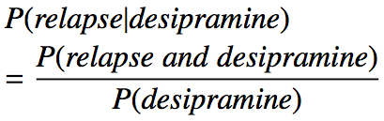
Conditional probability
The conditional probability of the outcome of interest A given condition B is calculated as

Slide 46

Conditional probability
The conditional probability of the outcome of interest A given condition B is calculated as

Slide 47

Conditional probability
The conditional probability of the outcome of interest A given condition B is calculated as

Slide 48

Conditional probability
The conditional probability of the outcome of interest A given condition B is calculated as

Slide 49
General multiplication rule
If two events are independent, their joint probability is simply the product of their probabilities. If the events are not believed to be independent, the joint probability is calculated slightly differently.

Slide 50
General multiplication rule
If two events are independent, their joint probability is simply the product of their probabilities. If the events are not believed to be independent, the joint probability is calculated slightly differently.
If A and B represent two outcomes or events, then P(A and B) = P(A | B) x P(B) Note that this formula is simply the conditional probability formula, rearranged.

Slide 51
General multiplication rule
If two events are independent, their joint probability is simply the product of their probabilities. If the events are not believed to be independent, the joint probability is calculated slightly differently.
If A and B represent two outcomes or events, then P(A and B) = P(A | B) x P(B) Note that this formula is simply the conditional probability formula, rearranged.
It is useful to think of A as the outcome of interest and B as the condition.

Slide 52
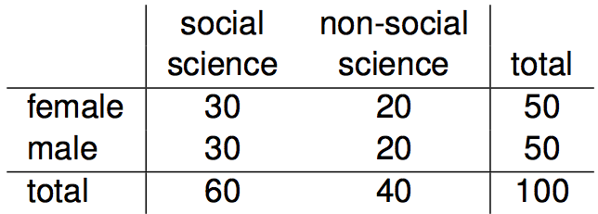
Independence and
conditional probabilities
Consider the following (hypothetical) distribution of gender and major of students in an introductory statistics class:

Slide 53
Independence and
conditional probabilities
Consider the following (hypothetical) distribution of gender and major of students in an introductory statistics class:
The probability that a randomly selected student is a social science major is

Slide 54
Independence and
conditional probabilities
Consider the following (hypothetical) distribution of gender and major of students in an introductory statistics class:
The probability that a randomly selected student is a social science major is
60 / 100 = 0.6.

Slide 55
Independence and
conditional probabilities
Consider the following (hypothetical) distribution of gender and major of students in an introductory statistics class:
The probability that a randomly selected student is a social science major is
60 / 100 = 0.6.
The probability that a randomly selected student is a social science major given that they are female is

Slide 56
Independence and
conditional probabilities
Consider the following (hypothetical) distribution of gender and major of students in an introductory statistics class:
The probability that a randomly selected student is a social science major is
60 / 100 = 0.6.
The probability that a randomly selected student is a social science major given that they are female is
30 / 50 = 0.6.

Slide 57
Independence and
conditional probabilities
Consider the following (hypothetical) distribution of gender and major of students in an introductory statistics class. Are major and gender independent random variables?
The probability that a randomly selected student is a social science major is
60 / 100 = 0.6.
The probability that a randomly selected student is a social science major given that they are female is
30 / 50 = 0.6.
Since P(SS | M) also equals 0.6, major of students in this class does not depend on their gender: P(SS | F) = P(SS). Therefore major and gender are independent.

Slide 58
Independence and
conditional probabilities (cont.)
Generically, if P(A | B) = P(A) then the events A and B are said to be independent.

Slide 59
Independence and
conditional probabilities (cont.)
Generically, if P(A | B) = P(A) then the events A and B are said to be independent.
Conceptually: Giving B doesn’t tell us anything about A.

Slide 60

Independence and
conditional probabilities (cont.)
Generically, if P(A | B) = P(A) then the events A and B are said to be independent.
Conceptually: Giving B doesn’t tell us anything about A.
Mathematically: We know that if events A and B are independent, P(A and B) = P(A) x P(B). Then,

Slide 61
Normal distribution

Slide 62
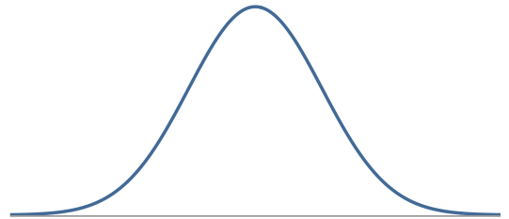
Normal Distribution
Unimodal and symmetric, bell shaped curve
Many variables are nearly normal, but none are exactly normal
Denoted as N(µ, σ) → Normal with mean µ and standard deviation σ

Slide 63
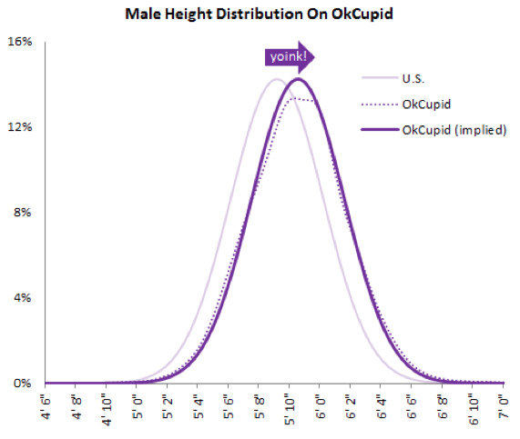
Heights of males

Slide 64
Heights of males
“The male heights on OkCupid very nearly follow the expected normal distribution -- except the whole thing is shifted to the right of where it should be. Almost universally guys like to add a couple inches.”
“You can also see a more subtle vanity at work: starting at roughly 5' 8", the top of the dotted curve tilts even further rightward. This means that guys as they get closer to six feet round up a bit more than usual, stretching for that coveted psychological benchmark.”
http://blog.okcupid.com/index.php/the-biggest-lies-in-online-dating

Slide 65
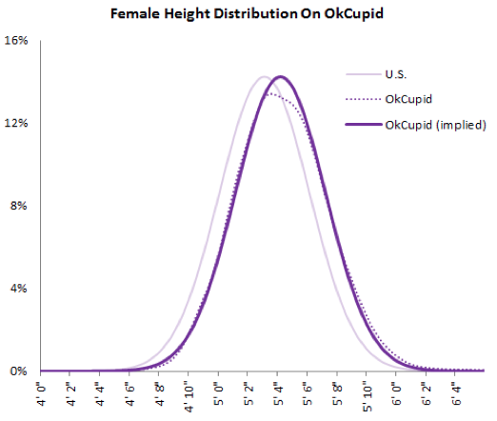
Heights of females

Slide 66
Heights of females
“When we looked into the data for women, we were surprised to see height exaggeration was just as widespread, though without the lurch towards a benchmark height.”
http://blog.okcupid.com/index.php/the-biggest-lies-in-online-dating

Slide 67
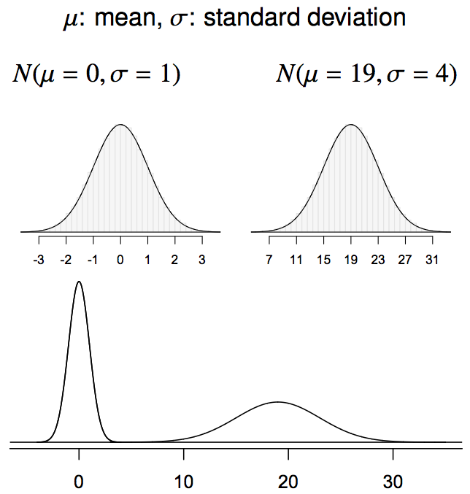
Normal distributions with different parameters

Slide 68
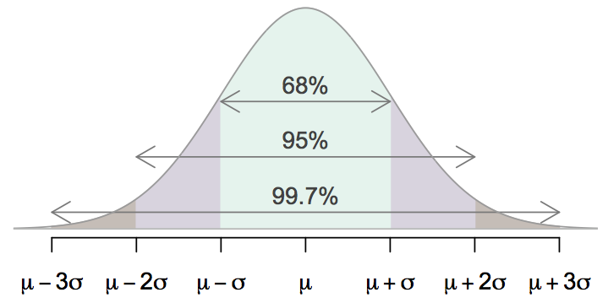
68-95-99.7 Rule
For nearly normally distributed data,
about 68% falls within 1 SD of the mean,
about 95% falls within 2 SD of the mean,
about 99.7% falls within 3 SD of the mean.
It is possible for observations to fall 4, 5, or more standard deviations away from the mean, but these occurrences are very rare if the data are nearly normal.

Slide 69
Describing variability using the 68-95-99.7 Rule
SAT scores are distributed nearly normally with mean 1500 and standard deviation 300.

Slide 70
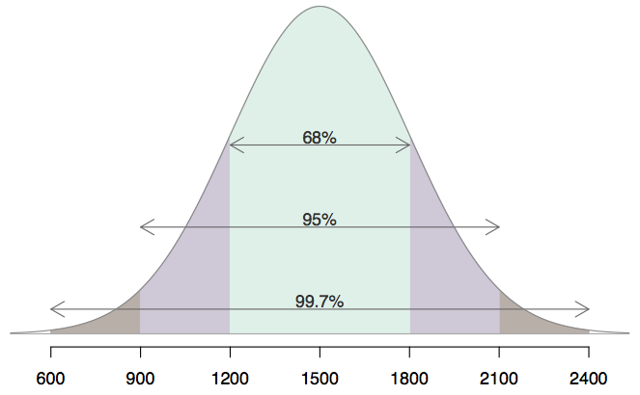
Describing variability using the 68-95-99.7 Rule
SAT scores are distributed nearly normally with mean 1500 and standard deviation 300.
~68% of students score between 1200 and 1800 on the SAT.
~95% of students score between 900 and 2100 on the SAT.
~$99.7% of students score between 600 and 2400 on the SAT.

Slide 71
Uniform Distribution

Slide 72
Uniform Distribution
A Uniform Distribution has equally likely values over the range of possible outcomes.
A graph of the uniform probability distribution is a rectangle with area equal to 1.

Slide 73
Example
The figure below depicts the probability distribution for temperatures in a manufacturing process. The temperatures are controlled so that they range between 0 and 5 degrees Celsius, and every possible temperature is equally likely.
P(x)
0.2
0
x
0 1 2 3 4 5
Temperature (degrees Celsius)

Slide 74
General Uniform Distribution
A Uniform Distribution has equally likely values over the range of possible outcomes, say c to d.

Slide 75
Sampling

Slide 76
Population
Population: A population is an entire collection of objects or individuals about which information is desired.
Populations are often hard to measure exactly.
If we want to measure the percentage of Trump voters in the United States, the population is all eligible voters in the United States.
Some populations are known in their entirety.
If we want to know the percentage of female employees at Lockheed in Liverpool, the population is all Lockheed Liverpool employees

Slide 77
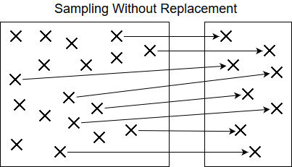
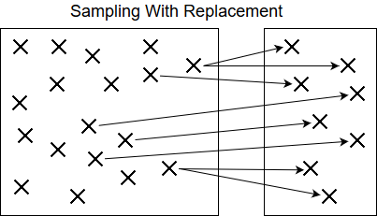
Sampling
What do we do if the population is too large to work with: Like the United states population?
Sample: A sample is a subset of a population.
Ex: A sample of 1000 prospective voters for the Trump vs. Clinton election
Samples can be drawn from a population with or without replacement.
Sampling with or without replacement depends on context
Notes:
Example with replacement: Sampling for boosting / bootstrap

Slide 78


Sampling Continued …
The process of sampling is a natural process, we do it in our everyday lives …
If you walked into an unfamiliar store and wanted to determine if the store was expensive or not, you would not check every price in the store; but rather, you would check the prices of a variety of items.
If you are cooking a batch of spaghetti sauce and wanted to check the quality, you would taste a small sample instead of the entire batch.

Slide 79
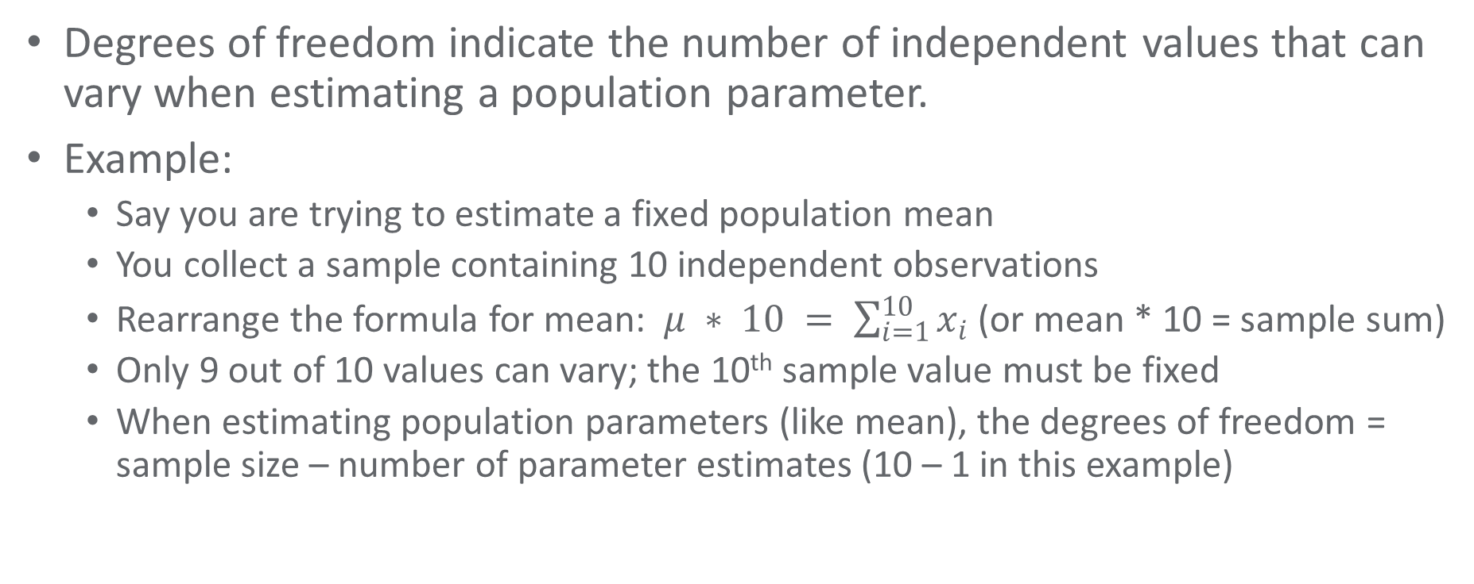
Degrees of Freedom
Degrees of freedom indicate the number of independent values that can vary when estimating a population parameter.
Example:
Say you are trying to estimate a fixed population mean
You collect a sample containing 10 independent observations
Rearrange the formula for mean: $μ ∗ 10 = \sum_{i=1}^{10}{x_{i}}$ (or mean * 10 = sample sum)
Only 9 out of 10 values can vary; the 10th sample value must be fixed
When estimating population parameters (like mean), the degrees of freedom = sample size – number of parameter estimates (10 – 1 in this example)

Slide 80
Bessel’s Correction
Bessel was a French Mathematician
Bessel’s Correction uses the notion of degrees of freedom to improve the estimate of population variance when estimated from sample data.
Math Fact: Sample variance is always less than or equal to population variance (assuming sampling with replacement).
Bessel’s correction: Subtracting 1 from the number of sample observations in the variance formula produces a better estimate of the population variance.
See: https://en.wikipedia.org/wiki/Bessel%27s_correction

Slide 81
Covariance
Covariance measures the linear relationship between 2 random variables.
Positive covariance means as X increases, Y also increases
Negative covariance means as X increases, Y decreases
Does have units, ranges from + infinity to - infinity
Not normalized so it’s hard to tell the degree of co-variation based on the resulting number.
The sign is what matters when interpreting covariance

Slide 82
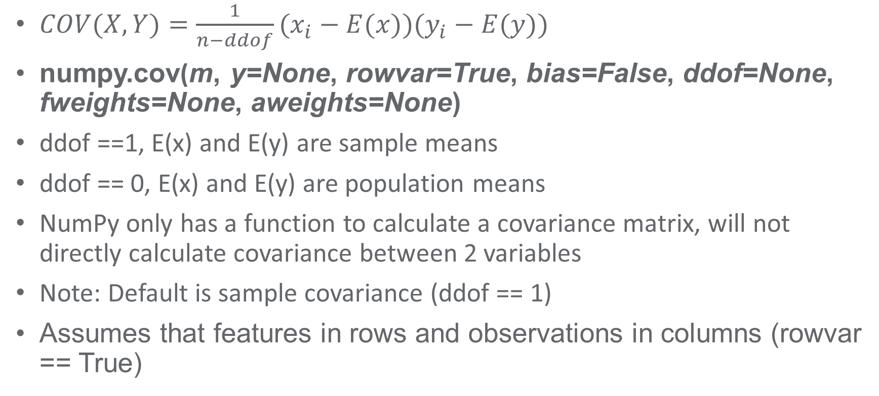
Covariance Continued …
$COV(X,Y)=\frac{1}{n−ddof}(x_{i}−E(x))(y_{i}−E(y))$
numpy.cov(m, y=None, rowvar=True, bias=False, ddof=None, fweights=None, aweights=None)
ddof ==1, E(x) and E(y) are sample means
ddof == 0, E(x) and E(y) are population means
NumPy only has a function to calculate a covariance matrix, will not directly calculate covariance between 2 variables
Note: Default is sample covariance (ddof == 1)
Assumes that features in rows and observations in columns (rowvar == True)

Slide 83
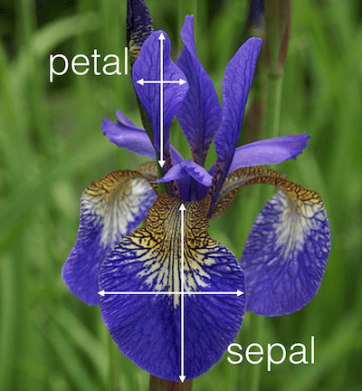
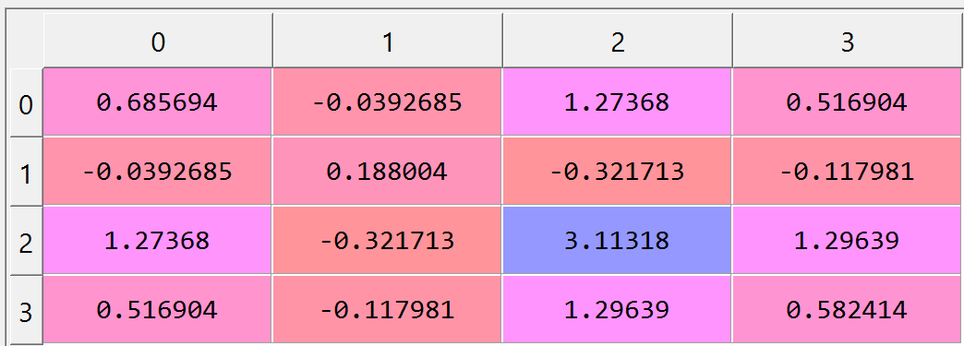
Iris Data Covariance Matrix Example
Iris Dataset comes from Statistician Ronald Fisher in 1936
Covariance matrix for Iris data set.
Cols: Sepal Length, Sepal Width, Petal Length and Petal Width
Diagonal represents variance. For example, matrix[0][0] is sepal length variance

Slide 84
Correlation Coefficient
Correlation measures the linear relationship between 2 random variables.
Dimensionless (no units)
Ranges from -1 to 1 where the absolute correlation suggests the degree of correlation.
Size and sign matters
+1 is perfect positive correlation, -1 is perfect negative correlation, 0 is completely uncorrelated.

Slide 85
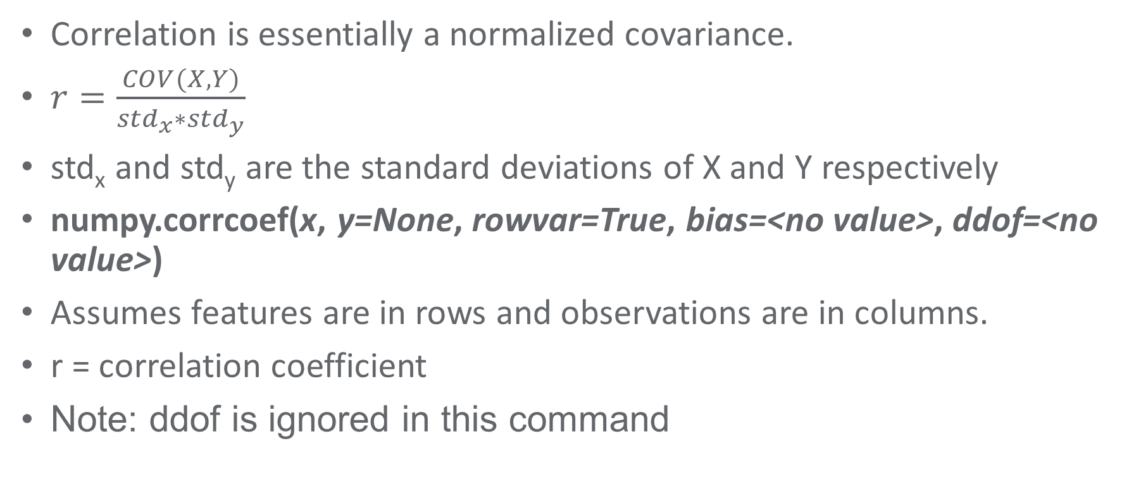
Correlation Continued
Correlation is essentially a normalized covariance.
$r=\frac{COV(X,Y)}{{std}_{x}∗{std}_{y}}$
std_{x} and std_{y} are the standard deviations of X and Y respectively
numpy.corrcoef(x, y=None, rowvar=True, bias=<no value>, ddof=<no value>)
Assumes features are in rows and observations are in columns.
r = correlation coefficient
Note: ddof is ignored in this command

Slide 86

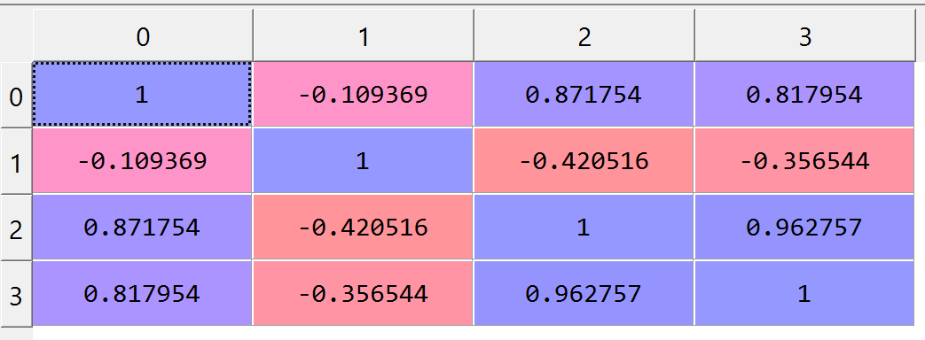
Iris Data Correlation Matrix Example
Correlation matrix for Iris dataset
Cols: Sepal Length, Sepal Width, Petal Length and Petal Width
Assumes that features in rows and observations in columns (rowvar == True)

Slide 87
Correlation Rules of Thumb
Correlation Magnitude | Interpretation
0.00 – 0.20 | Very Weak
0.20 – 0.40 | Weak to Moderate
0.40 – 0.60 | Medium to Substantial
0.60 – 0.80 | Very Strong
0.80 – 1.00 | Extremely Strong

Slide 88
Correlation / Covariance Summary
Covariance provides the direction of a linear relationship between 2 variables
Correlation provides the direction and strength of a linear relationship between 2 variables
Covariance has units and ranges from negative infinity to positive infinity
Correlation is unitless and ranges from -1 to +1
Both can provide misleading results if provided with outliers or non linear data
Both provide a measure of association, not causation

